Slide 1
Verification of Flight Ready Hybrid Rocket Motor
Presenter:
Ryan Stoner
Partner:
Deyzi Ixtabalan
Arizona State Univeristy

Slide 2
Objectives
Project Goals
Design
Fabrication
Initial Testing
Future Improvements

Slide 3
Project Goals
Identify Design Requirements
Produce an average thrust of 300lbf
Ten second burn time
Develop hybrid subsystems to accomplish steady thrust
Conceptual Design Development
Structural Design
Cold Flow Testing
Hot Fire Testing
Flight Test

Slide 4
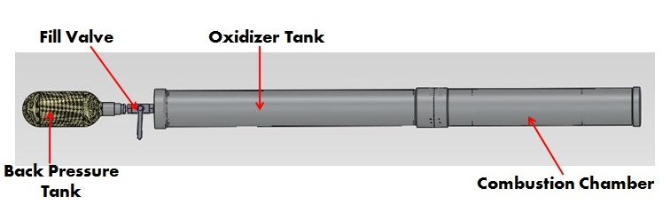
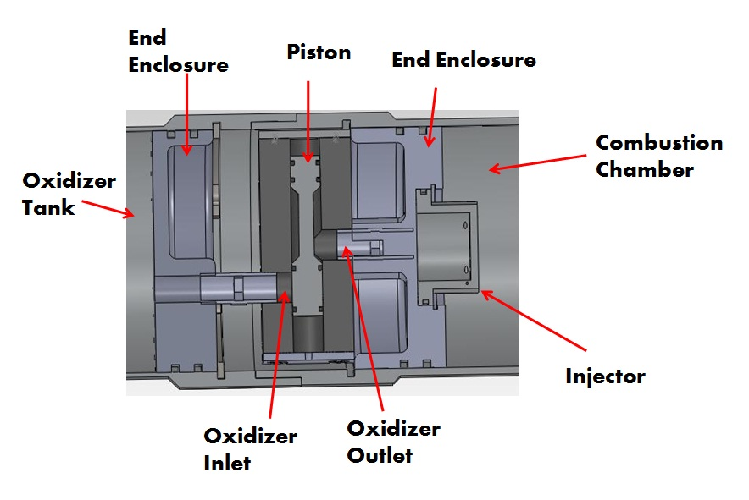
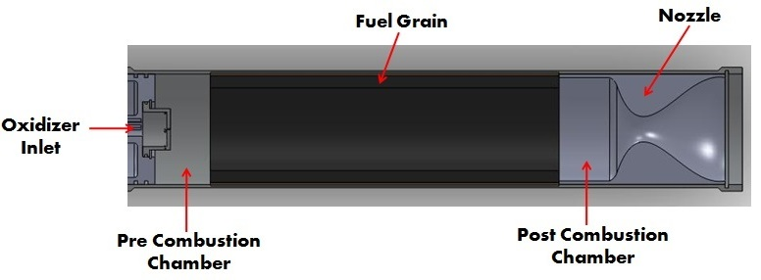
Design of Motor

Slide 5
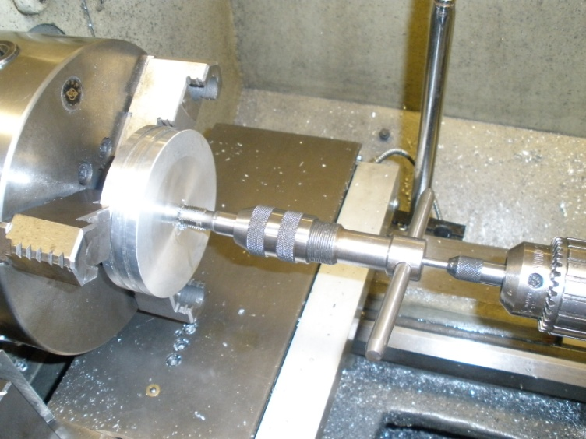
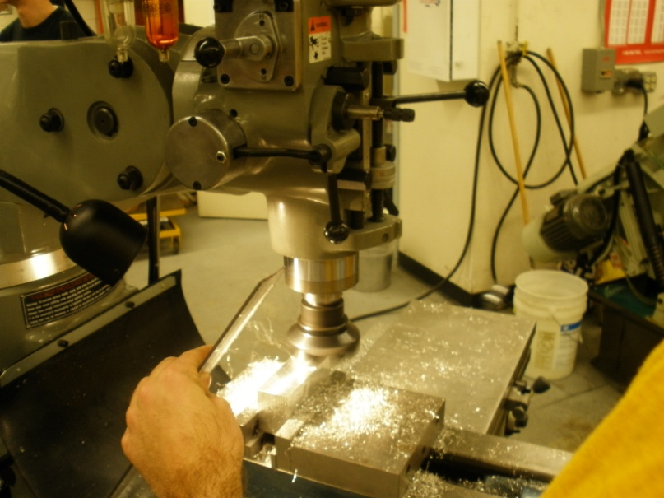
Fabrication
All components were machined at the student machine shop
Both the mill and lathe were used

Slide 6

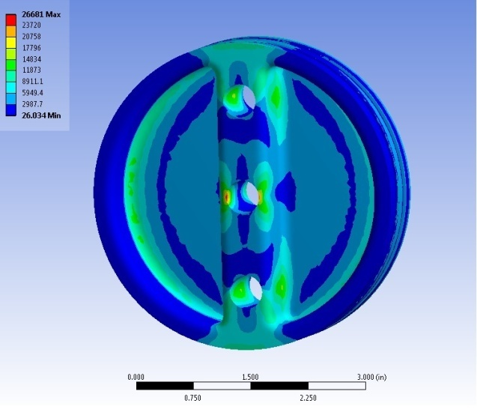
Fabrication
Finite Element Analysis was used to verify that the parts would withstand the forces that would be applied

Slide 7
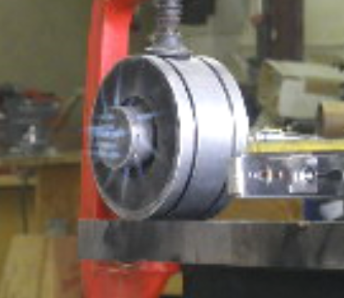
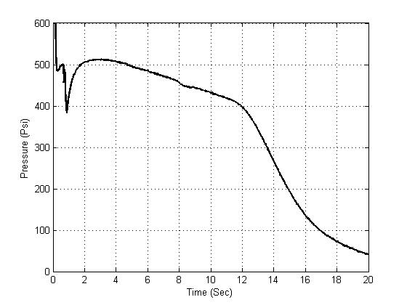
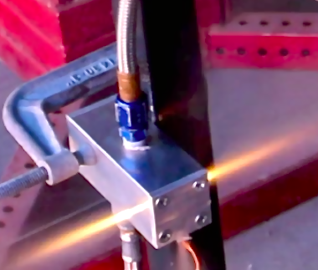
Initial Testing
Tank Pressure During Cold Flow Test

Slide 8
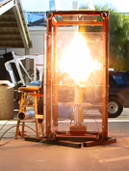
Future Improvement
Replace the pyrotechnic valve with a solenoid valve
Connecting a timer to oxidizer valve
Implementing a piston in the oxidizer valve

Slide 9
Acknowledgements
Special Thanks to:
Mentor: Matt Summers
Institution: ASU/NASA Space Grant

